Slide 1


Java ee
(ADVANCE JAVA)
Lecture-18

Slide 2
Today’s Agenda
List Of Implicit Objects In A JSP Page
Comments
The MVC Model

Slide 3
IMPLICIT OBJECTS
The JSP technology provides us 9 predefined objects which we can always use in every JSP page .
These objects are predefined so we don’t have to create them our self rather they are automatically created by the container for us .

Slide 4
LIST OF OBJECTS
out : JspWriter (class)
request : HttpServletRequest (interface)
response : HttpServletResponse(interface)
session : HttpSession (interface)
config : ServletConfig (interface)
application : ServletContext (interface)
pageContext : PageContext (class)
exception : Throwable (class)
page : Object (class)

Slide 5
COMMENTS
Comments in a jsp page can be of 3 types :
Java Comments:
Java comments are written using java comment
syntax and can only be used within a scriplet or a
declarative tag and since it is a comment it is not
processed at all neither it is displayed by browser.
Syntax:
//
/* */

Slide 6
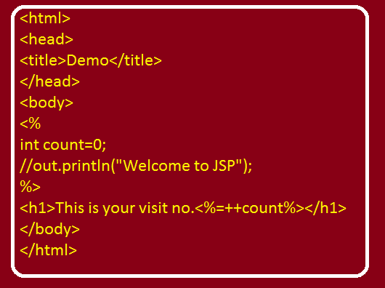
EXAMPLE

Slide 7
HTML COMMENTS
If an html comment is given in the JSP page then although it is not displayed by the browser in the page output but the container evaluates it and sends the response to the browser which the browser doesn’t display .
Syntax:
<!-- -- >

Slide 8
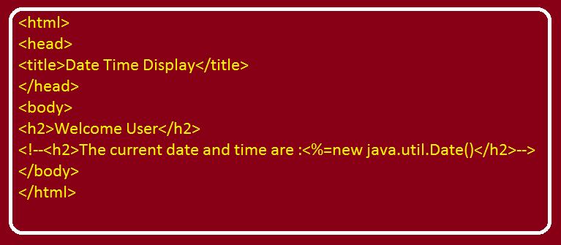
EXAMPLE

Slide 9
HTML COMMENTS
When the container will encounter the above statement it will evaluate the Java Expression given inside the HTML comment and will send back the evaluated result i.e the browser will receive the following :
<!--<h2>The current date and time are: Mon September 12 2016, 20:30:00 IST </h2>-- >

Slide 10
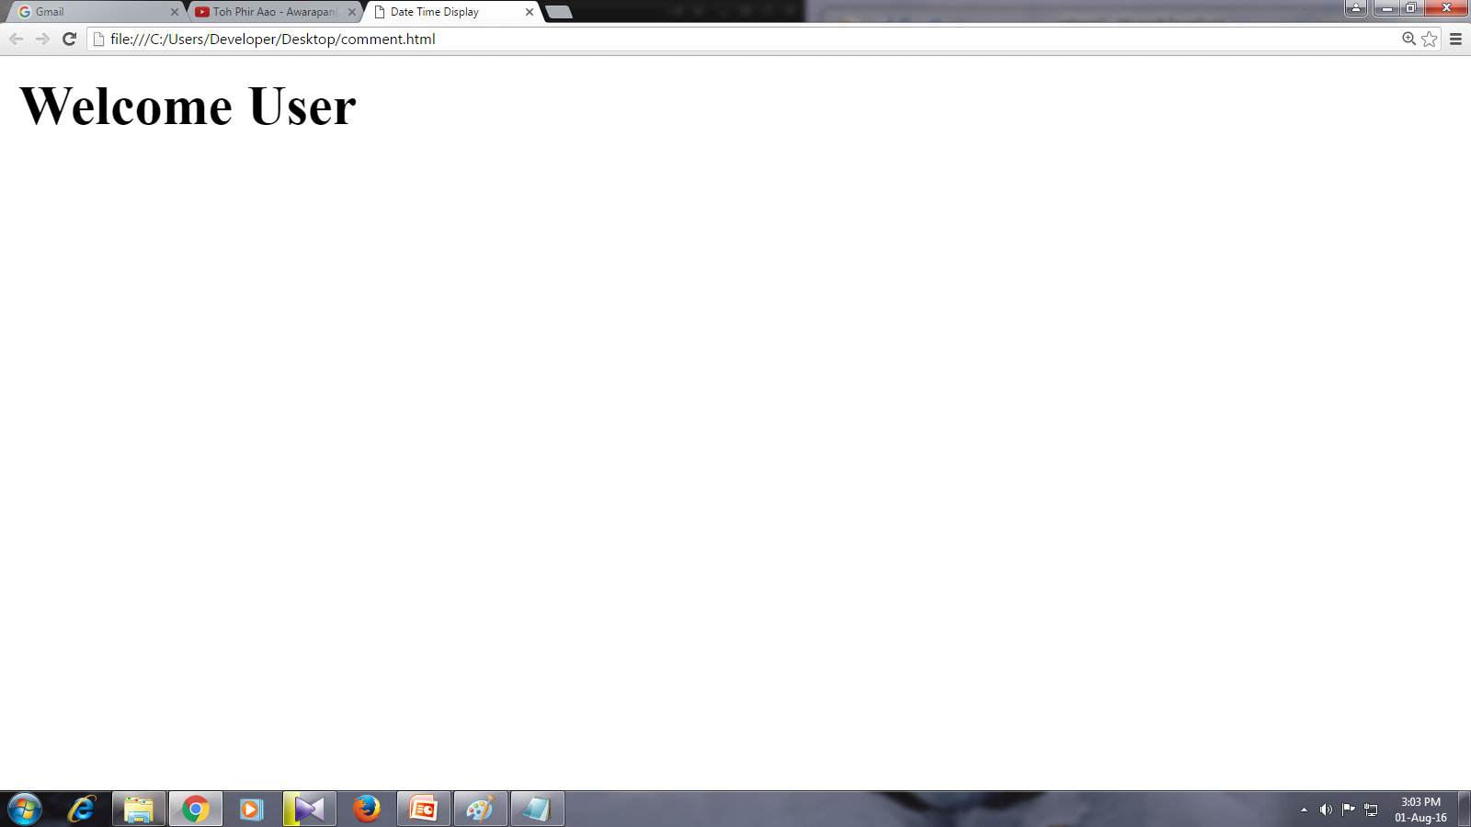
OUTPUT

Slide 11
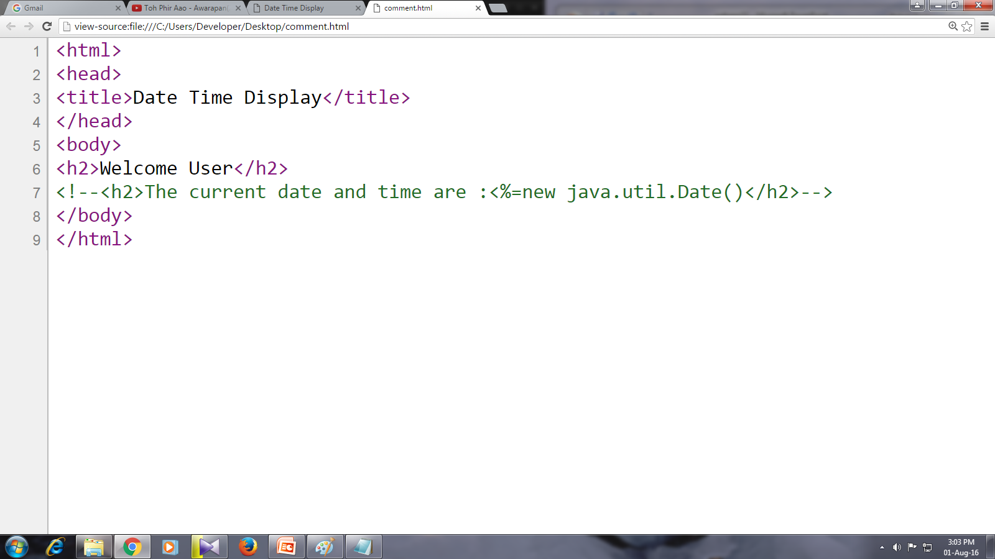
SOURCE CODE

Slide 12
JSP COMMENTS
JSP comments have the following syntax:
<%- - jsp code %>
The code contained in commented area is neither passed to servlet nor passed to the browser .
It only remains there so that programmer can read it in future to know about the status of his code .i.e to recall any programming logic he has given .

Slide 13
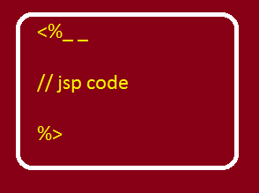
SYNTAX

Slide 14
WEB APPLICATION DEVELOPMENT MODELS
Web Application Development is a complicated area having a combination of multiple technologies .
Among these technologies we have various developers coming from different backgrounds.
Now to bring uniformity amongst all these developers, the IT industry has developed some strict guidelines which must be followed whenever we develop web applications.

Slide 15
WEB APPLICATION DEVELOPMENT MODELS
These guidelines are called as design patterns or web application development models .
And the most popular is the MVC Pattern .

Slide 16
MVC
The term MVC represents :
M – model
V – view
C – controller

Slide 17
WHAT IS MODEL ?
The term model means a simple Java class (also called as DAO) which takes the responsibility of communicating with the database or any other datasource .
This is because in almost every web application database interaction is involved .
Now , while seperating the database interaction code from servlets and Jsp and putting them inside the simple java class we achieve a concept called Separation Of Concern

Slide 18
WHAT IS MODEL IN MVC ?
Means every component should play a different role and the responsibility of database communication goes to a normal Java class .
Now suppose in future the backend changes from Oracle to My Sql then we would just have to edit our model class .

Slide 19
WHAT IS VIEW ?
The view component in MVC is used to generate response to the browser and thus whatever the user visualizes on his browser is produced from the view part .
Most of the time these view part are JSP or HTML pages but they can also be other response generating technologies like : velocity , WML.

Slide 20
WHAT IS VIEW ?
The main advantage of this approach is that if in future the presentation logic needs to be changed for ex : we need to change the color of the page then only the JSP portion needs to be updated without disturbing Model or Controller .

Slide 21
WHAT IS CONTROLLER ?
The heart of MVC architechture is the Controller which is actually a java servlet which receives the request from the user (HTML Page).
And manages the flow of data between the view and model layers .

Slide 22
WHAT IS CONTROLLER ?
Thus , we can say that a controller controls the way views and models parts will interact with each other
So , every standard web application always follows the MVC design pattern .

Slide 23
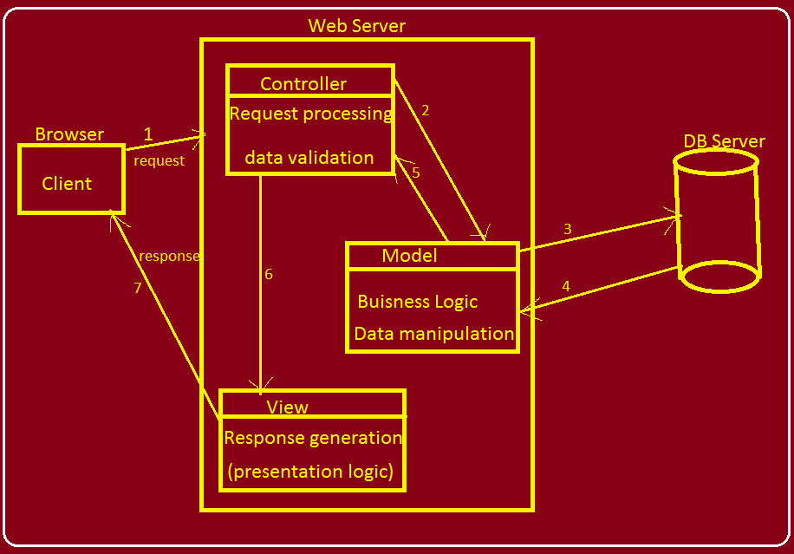
MVC BLOCK DIAGRAM

Slide 24
EXERCISE
Write an MVC based web application that searches and displays the details of the books by accepting subject name from the user. Following should be the important components of your application:
An html page for typing the subject name
A Controller Servlet for receiving the request
A Model java class for fetching and returning books belonging to the given subject from the database.
A View JSP page for displaying the details of the books.
A page for displaying the message no books found along with the subject name
An error page for invalid input

Slide 25
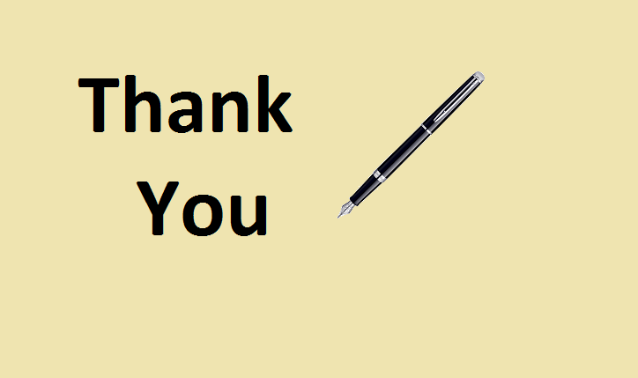
End Of Lecture
For any queries mail us @: scalive4u@gmail.com
Call us @ : 0755-4271659, 7879165533
Agenda for Next Lecture:
Introduction To JSP Directives
The @page Directive
Attributes of @page Directive
The @include Directive

